Slide 1
Learning for exams
Tutor*in:

Slide 2
Agenda
Studying methods and strategies
ANKI
Dealing with stress

Slide 3

Goals
Learning effectively and efficiently → maximizing your free time :D
Understanding and keeping knowledge for a long time
Having fun!
Notes:
To you: set goals / create a Common Sense

Slide 4
Are there “better” learning methods?
summarizing
highlighting, underlining
re-reading
cramming
Are neither efficient nor effective methods!
Notes:
To you: Make aware of study methods that are inefficient and ineffective. The problem with these is that they don’t use the learning time to the fullest although everybody would wish that since the result would be more free time. The ultimate goal is to spend as little time as possible with learning and get better results by using that time effectively. You can easily gain an advantage over others by upgrading your methods-toolbox.
Work smart not hard... They say. This means that you can easily gain an advantage over others by upgrading your methods toolbox.

Slide 5
Which methods do you know or use?
How would you like to approach learning in this semester?
How will your approach differ from your previous one?
Notes:
To you: start an open discussion

Slide 6
Promising learning methods
Spaced Repetition
Mnemonic
Active Recall
Self-Explanation
Elaboration
Interleaving
Breaks
Notes:
To you: Learning psychology suggests that these are the most important (effective and efficient) learning methods.

Slide 7
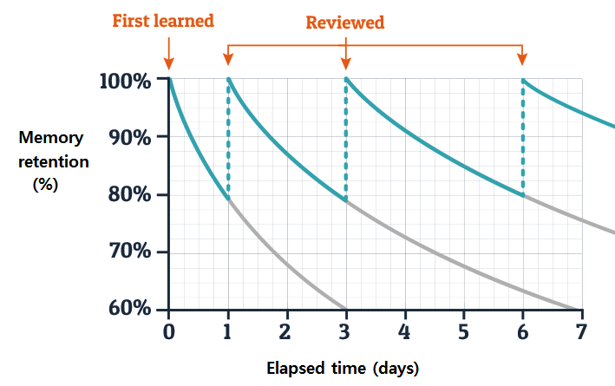
Spaced Repetition
Repetition at steadily increasing intervals
Human forget learned information at an exponential rate
The exact time intervals vary from person to person
Forgetting is human and has little to do with intelligence!
ResearchGate: Ebbinghaus' forgetting curve and review cycle
Berry 1983, Brainzucker
Notes:
To You: Describe the human forgetting curve as exponential decay. To emphasize that it really applies to everyone and that forgetting is absolutely unavoidable. However, the gradient can be minimized through repetition, which means that information is remembered for longer. Repetition at steadily increasing intervals leads to long-term storage!

Slide 8

Case: Marie is writing a statistics exam in two weeks. She has to learn the follwoing topics. How would you design a learning plan in her place? The traffic light colors show what she already knows very well (green), what she understands but doesn't know in detail (yellow) and absolute areas of improvement (red).
 |  | 0,0h | 0,0h | 0,0h | 0,0h | 0,0h | 0,0h | 0,0h | 0,0h | 0,0h | 0,0h | 0,0h | 0,0h | 0,0h | 0,0h | 0,0h | 0,0h
 | Level | Sa, 14.1. | Su, 15.1. | Mo, 16.1. | Tu, 17.1. | We 18.1. | Th, 19.1. | Fr, 20.1. | Sa, 21.1. | Su, 22.1. | Mo, 23.1. | Tu, 24.1. | We 25.1. | Th, 26.1. | Fr, 27.1. | Sa, 28.1. | Su, 29.1. | Mo, 30.1.
Inferential Statistics
V1 Parameters and how to estimate them |  |  |  |  |  |  |  |  |  |  |  |  |  |  |  |  |  | Exam
V2 Matrix Algebra
V3 WDH Reprise correlation, t-test, linear regression, ANOVA
V4 GLM
V5 Moderation, mediation, bootstrap
V6 Model Comparison and Mediation
V7 ANCOVA
V8 Paired and one-sample t-test/ANOVA
V10 Multilevel modeling
V11: Logistic Regression
V12 Outliers & co.
V13 Bayesian statistics I
Notes:
To the students: Exercise: Create an exemplary learning plan - there is no right or wrong. The colors are to be understood as evaluations. You can/must take break days to learn effectively. Just as in competitive sports, rest days must be planned. Forgetting is essential in that when you repeat the information, it is remembered more than the last time. So give yourself enough time to forget!

Slide 9
That is how Marie could have studied...
WiSe 2023/24
 |  | 4,0h | 4,0h | 2,0h | 4,0h | 4,0h | 4,0h | 3,0h | 3,0h | 3,0h | 3,0h | 1,0h | 2,0h | 2,0h | 3,0h | 1,0h | 3,0h
 | Level | Sa, 14.1. | Su, 15.1. | Mo, 16.1. | Tu, 17.1. | We 18.1. | Th, 19.1. | Fr, 20.1. | Sa, 21.1. | Su, 22.1. | Mo, 23.1. | Tu, 24.1. | We 25.1. | Th, 26.1. | Fr, 27.1. | Sa, 28.1. | Su, 29.1. | Mo, 30.1.
Inferential Statistics
V2 Matrix Algebra |  | L | L |  | L |  |  |  |  | L | L |  |  |  |  |  | L | Exam
V11: Logistic Regression |  | L | L |  | L |  |  | L |  |  |  |  | L |  | L
V10 Multilevel modeling |  | L | L |  |  | L |  |  | L |  |  |  |  | L
V13 Bayesian statistics I |  | L |  |  |  | L | L |  |  |  |  | L |  |  |  | L
V7 ANCOVA |  |  | L | L |  |  | L |  |  | L |  |  |  |  |  |  | L
V8 Paired and one-sample t-test/ANOVA |  |  |  | L | L | L |  |  | L |  |  |  | L
V4 GLM |  |  |  |  | L | L |  |  | L |  |  |  |  | L
V5 Moderation, mediation, bootstrap |  |  |  |  |  |  | L | L |  |  | L |  |  |  | L
V6 Model Comparison and Mediation |  |  |  |  |  |  | L |  |  | L |  |  |  |  |  |  | L
V12 Outliers & co. |  |  |  |  |  |  |  | L |  |  | L |  |  |  | L
V1 Parameters and how to estimate them |  |  |  |  |  |  |  | L |  |  |  |  |  |  |  | L
V3 WDH Reprise correlation, t-test, linear regression, ANOVA |  |  |  |  |  |  |  |  | L |  |  | L |  | L
Notes:
To the students:
Explanation:
The areas marked in red were tackled as early as possible and repeated in comparatively short time intervals.
if a topic like Logistic Regression does not want to go into your head at all, then it might take 3 days of practice in succession for this topic. But days off are not less important!
If time is spare, memory tricks like mnemonics or other mnemonic techniques can be very efficient solutions
so that everything is "fresh" for the exam, it was planned that all areas are practiced in the last 3 days
It is noticeable that the second week is more relaxed. If you are looking for an even more relaxed study schedule, then you just need to start earlier.
We all need to keep our resources in mind. Not everyone can devote an additional 4 hours on workdays to exam preparation. Often, study periods for multiple exams overlap. It can be helpful to make these learning plans among ourselves in Excel to coordinate learning planning with all events and exam performances. In the end, we all have to look at what we can and want to invest. At this point, it should only be emphasized that consistency in learning is key.

Slide 10
Spaced Repetition in the studying plan
Chose the next revision date based on your previous assessment and number of previous reviews as such:
  hard:: red = +1 day
  medium: yellow = +3 days
  easy: green = +1 week
Multiply by the number of the previous reviews
Notes:
The learning schedule could also look like this

Slide 11



Mnemonic
Mnemonic (pronounced ni-mon-ik, greek „to remember“) or memory aid, is a tool that helps you remember an idea or phrase with a pattern of letters, numbers, or relatable associations. Mnemonic devices include:
  Rhymes and poems
  Acronyms
  Images
  Songs
  Outlines
Mnemonic example:
  7 moderating factors of conformity (psychology major)
    Deindividuation, Informational influence, Social loafing, Culture,
    Group size, Unamity, Normative influence
DISC GUN
Literary Terms 2015
Notes:
To the students: There are plenty of mnemonic techniques (memory aids). There are very complex techniques but you can get really far with the classical mnemonic already. If you want to learn sequences, a funny mnemonic will stay in your head for sure while dull steps won’t. I have one example from my 1st semester in Psychology which is about remembering the moderator variables in the conformity experiment by Salomon Asch in the 50s. (DISC GUN). If you’re willing to put more effort into it, there are fun ways to turn numbers into images and place scenes of hilarious situation in your personal memory palace. If you’re interested in learning such techniques, you might want to read the additional information.
(Original quote:
„A mnemonic, also known as a memory aid, is a tool that helps you remember an idea or phrase with a pattern of letters, numbers, or relatable associations. Mnemonic devices include special rhymes and poems, acronyms, images, songs, outlines, and other tools. Mnemonic (pronounced ni-mon-ik) is derived from the Greek phrase mimnēskesthai meaning to “remember.”“)

Slide 12

Active Recall
… the attempt of recall the answer to a question from memory without using any external help.
Re-reading is pointless because you don‘t actively recall the knowledge from your memory
Only through self-testing knowledge gaps can be recognized
Typical application example: flashcards
Notes:
To the students: Very important method. Which is probably still familiar from learning vocabulary at school. But have you ever wondered why it is only used to learn vocabulary? Write all possible and important w-questions or content-related comprehension questions on the front, think about how to answer them perfectly and write your best solution on the back. Then it's just a matter of memorizing! And that should no longer be a problem if the explanation is your own words and formulated in simple language.

Slide 13
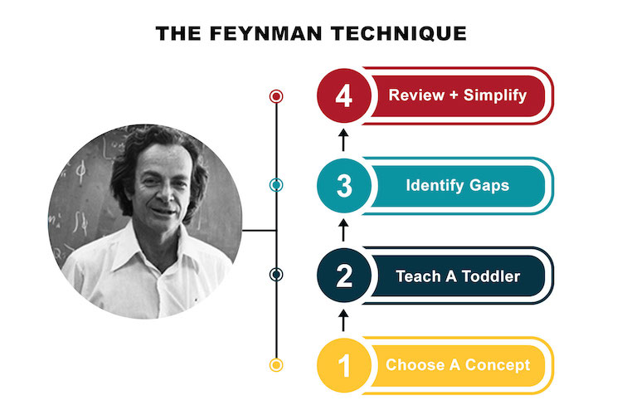
Self-Explanation
…asking questions to connect the dots and create holistic knowledge about a subject
What?
When?
Why?
Discipline-specific questions…?
→ Tip: form study-groups
Berry 1983, Brainzucker
Notes:
To the students: You know when you want to proudly talk about something you think you know a lot about, but you can't answer an obvious question afterwards? Unfortunately, this usually means that you don't yet know all the important connections. so be the person who asks you the annoying questions to understand every step. it also helps to try to explain a topic in very simple language, according to the Feynman technique, so that even a child would understand it. When you try, you often realize gaps in your knowledge that can be filled. You can count yourself lucky if you find these gaps while you are learning and not just in the exam!
Tip: The advantage of a study group is that you can explain things to each other. This not only benefits the person listening/asking questions, but also the person explaining! It also keeps you accountable.
To you: At this point, initiate that the students form learning groups, e.g. for the methods test, or also for other exams depending on the composition of the students.

Slide 14

Elaboration
present the topic properly
talk about associations
explain concepts
making connections to other knowledge
answer a question / talk about a topic in detail
Ramin 2022
Notes:
To the students: With this method, you go beyond the topic and train your ability to differentiate between other phenomena/topics. Mind maps are your best friend here. It is similar to self-explanation because you also try to present a concept or topic in its entirety. The difference here lies in the complexity. With elaboration, you may go further and draw connections to other topics in order to test your entire knowledge for retrievability.
(Original Zitat:
„Elaboration is the act of thoughtfully laying out a topic, talking about associations, explaining concepts, drawing connections to other knowledge and in general being very verbose about answering a question or talking about a topic.“)

Slide 15
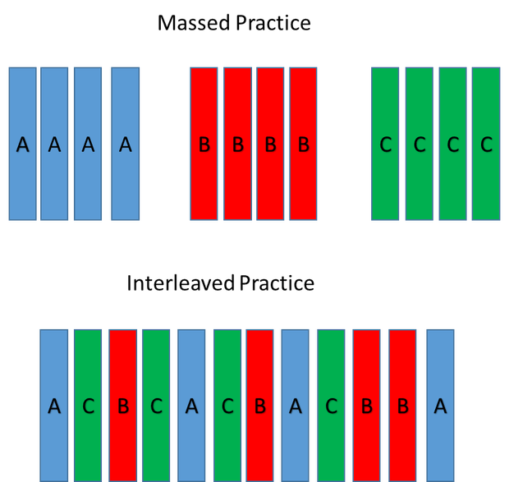
Interleaving
…changing topics while studying
It’s more effective to change subject shortly before reaching 100% understanding of the previous subject
Overlaps with the spacing-effect
Improves elaboration since knowledge is connected across subjects and detailed differences become apparent
Ramin 2022, Universe of Memory
Notes:
To the students: This method will be frustrating, but it easy to do and definitely effective. As a rule of thumb, every activity which is mentally exhausting has the biggest training effect. Re-reading a paragraph in your textbook is easy. No wonder you don’t get anything from that.

Slide 16

Breaks
„Take. Breaks. A lot.“
Pomodoro-Technique: 25minutes of learning, 5minutes breaks
Several short breaks are better than few long breaks
People are innately bad at estimating their own level of concentration and efficacy. In case of doubt, take a break!
Ramin 2022
Notes:
To the students: Breaks are essential. This applies to all areas, by the way. In sport, you regenerate during breaks, muscles are only built up then. It may also be reassuring to know that those who study non-stop for hours on end use their time ineffectively and that you are far ahead of them if you work less, but always with a high level of attention and receptivity.
Speaking of breaks: wouldn't now be a good time to take one ?:)

Slide 17
What difficulties could arise when implementing these learning methods?
Can you think of any solutions?
Notes:
To you: At this point, I would like to mention that everyone has to find their own learning strategy. Sticking to something because everyone else is doing it doesn't make sense if it doesn't work for you (e.g. - please replace with your own example - flashcards never worked for me because it took me far too long to write them. Instead, I implemented Active Recall by telling everything I knew about a topic ('blurting').
+ Encourage discussion about what implementation difficulties the students have had so far in their learning or anticipate them and consider solutions (as required).

Slide 18
You‘ve now learned about Spaced Repetition, Active Recall, Self-Explanation, Interleaving, and regular breaks. It takes quite a lot of commitment to think of everything every time.
Lucky you! We‘ve got technology.
Let me introduce:
ANKI

Slide 19
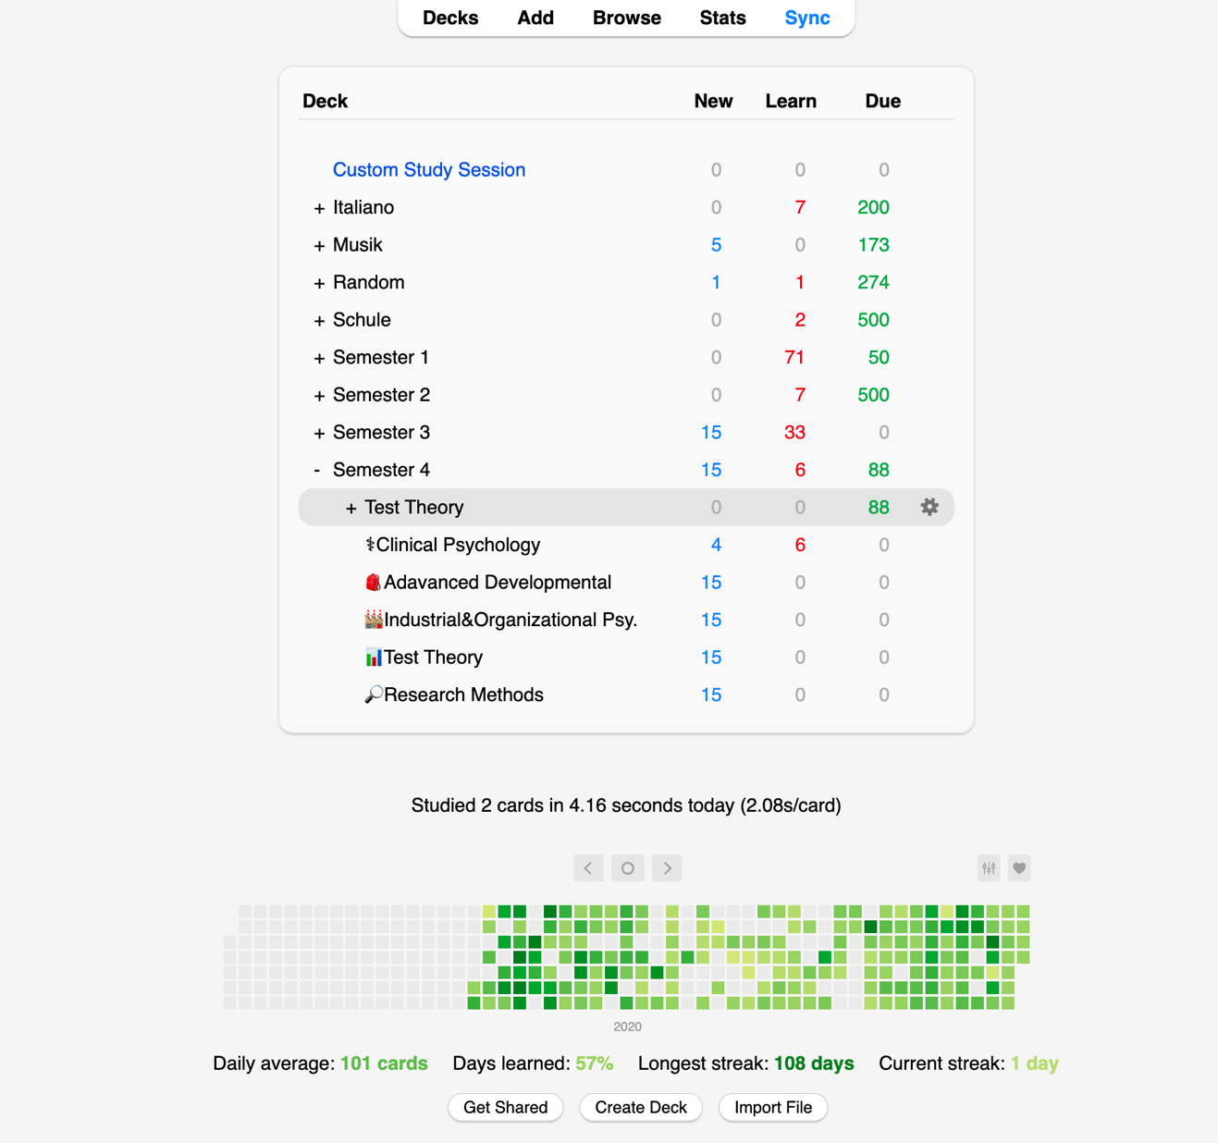

ANKI
Intigrated in the program:
Active Recall
Spaced Repetition
Interleaving
Breaks
Your own responsibility:
Self-explanation
Elaboration
Notes:
To the students: Anki is a computer program and is also available as an app. In terms of logic, it is a simple flashcard system, like the one you may have already had in paper form. However, this flashcard system is digital and offers many integration options, automation and personalization options. And it is open source. The vast majority of methods that are effective and efficient are already automated in the code, making the program ideal even for lazy learners.

Slide 20
Anki alternatives
 | Advantages | Disadvantages
ANKI | Open-source: offers all functions and setting options that you could wish for. Costs nothing. | No responsive user interface, cluttered and feeling of (context) „loose“ flashcards floating around.
RemNote | Flashcards are embedded coherently, and it can be used as a writing program at the same time, creating flashcards almost automatically - ideal for lazy ones. Essentially free of charge. | Bugs (but active further develoment and active support). AI features cost money.
Zorbi | Most beautiful user interface. Integrates very well with Notion. Essentially free of charge | Unfortunately, not so many settings options. AI-personalized learning programs only in the paid program.
Quizlet | AI-features, import of index cards from World possible. Very good user interface | Advertisement with standard program.
Notes:
To the students: Here are some alternatives if you dislike Anki for a reason.

Slide 21
Software installation and testing
LS-Semester Deck download and practise: https://lstemplates.notion.site/Leuphana-Templates-abb41bc9039a4263bfefc55c6701b77d
Optional
Notes:
To You: Let the students install and test it if they want and if they want to take the time for that in class

Slide 22
Dealing with stress
Risk leaving gaps in your knowledge – doing everything is impossible
  → 80/20 rule
Set your own pace
acknowledge stress as something psoitive
Practice exam situations
Practise stress in other areas like sports to get your body used to
Don‘t let social life fall short in stressful exam periods – it‘s the balance your mental health needs!
Video: So kann dir Stress in Prüfungen nützen | Quarks
Notes:
To you:
Present tips for dealing with stress, add your own. Perhaps also open a discussion round.
80/20 rule: 20 percent of the effort is responsible for 80 percent of the desired result.
The YouTube video shows once again what functions stress has for us, what happens in the body and how we can use this to our advantage.
If you feel that there is a need, feel free to mention the psychological counseling services offered by the university.

Slide 23
Related Wiki Articles
Mind Map: https://sustainabilitymethods.org/index.php/Mindmap
Feynman Method: https://sustainabilitymethods.org/index.php/Feynman_Method
Anki: https://sustainabilitymethods.org/index.php/Anki
AI in education: https://sustainabilitymethods.org/index.php/AI_in_education
Learning for exams: https://sustainabilitymethods.org/index.php/Learning_for_exams
Overcoming exam anxiety: https://sustainabilitymethods.org/index.php/Overcoming_Exam_Anxiety
Coping with psychological problems: https://sustainabilitymethods.org/index.php/Coping_with_psychological_problems
Co-working: https://sustainabilitymethods.org/index.php/Co-Working
Notes:
To You: a collection of Wiki articles that are related to the topic and where the students can further inform themselves

Slide 24
Sources
Berry, D. C. (1983): Metacognitive experience and transfer of logical reasoning. In: The Quarterly Journal of Experimental Psychology Section A, 35(1), 39–49.
Brainzucker (o.J.): What Is the Feynman Technique. Aberufen am 30.09.2023 unter: https://www.brainzucker.com/article/what-is-the-feynman-technique.
Dunlosky, J., Rawson, K. A., Marsh, E. J., Nathan, M. J., & Willingham, D. T. (2013): Improving students’ learning with effective learning techniques: Promising directions from cognitive and educational psychology. In: Psychological Science in the Public Interest, 14(1), 4-58.
Ebbinghaus, H. (1885): Über das Gedächtnis. Leipzig: Duncker & Humblot.
Literary Terms (2015): Retrieved November 3, 2015, from https://literaryterms.net/mnemonic/.
Ramin, M. (2022): Learning for exams. In: Sustainability Methods Wiki. Abgerufen am 30.09.2023 unter: https://sustainabilitymethods.org/index.php/Learning_for_exams.
ResearchGate (o.J.): Ebbinghaus Forgetting Curve and Review Cycle. Abgerufen am 30.09.2023 unter: https://www.researchgate.net/figure/Ebbinghaus-forgetting-curve-and-review-cycle_fig1_324816198.
Universe of Memory (o.J.): Interleaved Practise. When and how to use it to maximize your learning pace. Abgerufen am 30.09.2023 unter: https://universeofmemory.com/interleaved-practice-maximize-learning-pace/.

